Slide 1
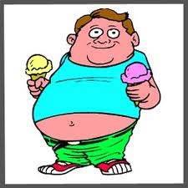
Obesity
By : imani , Tia , Alysha And Tyshawna

Slide 2
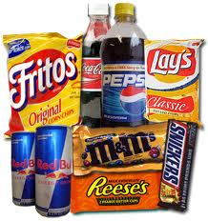
What Factors contribute to it ?
Increase consumption of sugar – sweetened beverages.
Increased snacking
Larger position sizes
Higher calorie – density of foods
More meals consumed / purchased away from home (fast foods)
More exposure to advertising
that encourages food consumption and
promotes unhealthy foods.

Slide 3
More Factors………..
Value sizing of less nutritious foods
Inadequate amounts of physical activity
Labor – saving technological advances
Increased media use
Auto – mobile oriented communities and reliance on motorized transportation.
Limited access to safe convenient recreation facilities or walking areas.

Slide 4
Limited opportunities for activity during the work day.
Limited time for physical education or recess during school.
Energy imbalance : eating too many calories and not getting enough physical exercise.
Changing environment has broadened food options and eating habits.
Pre – packaged food , fast food restaurants , and soft drinks are more accessible.
Increase in portion size - many people eat in response to negative emotions such as boredom , anger or sadness.
Woman have low self – esteem and / or depression

Slide 5
Woman are more likely to be obese than men. Woman have less muscle mass and tend to burn fewer calories at rest than men do.
One in three Americans are obese
Our environment does not support healthy lifestyle habits , it actually encourages obesity.
Lack of neighborhood side walks
Work schedules
Lack of access to healthy food
Food advertising
Lack of sleep.

Slide 6
Some Problems that led to obesity
Many of Americans favorite foods are deep fried and very easy and inexpensive to make.
Major US manufactures of processed foods are aware of the contribution their products have on obesity.
American families have become so into other activities , formal meal time has disappeared leading to increased smacking during the day.
Certain foods that were just for special occasions are now eaten year long be prepackaged food.
Sugary drinks affect genes that regulate weight
Giving children drinks high in sugar and calories
Not getting enough sleep

Slide 7
Solution
Since we know these things, why not change it?
The simple things we can do everyday like choosing healthier options when we eat, maintaining a healthy diet, and getting more active in our daily lives can cause a big difference nationwide.
Less screen time and spending more quality time with family and friends can decrease snacking throughout the day
As the people of America we should be encouraging our representatives in government to take more action with the food industry.

Slide 8
We need to invest in clinical research to find new ways to quickly eradicate this epidemic
Educational programs to address things like hypertension and high cholesterol to bring more awareness to the public.
This is a nationwide effort and it’s gonna take a determined investment to end this epidemic and change the life expectancy of this generation.

Slide 9
